Slide 1



Rock the Earth
Jay Sebastian, Joseph Baik, Michael Chen, Hans He, Mike Park, Jiu Moon

Slide 2
Problem
Modern and efficient way of petitioning/raising social support
Efficient way of gathering and organizing data
Raising awareness

Slide 3
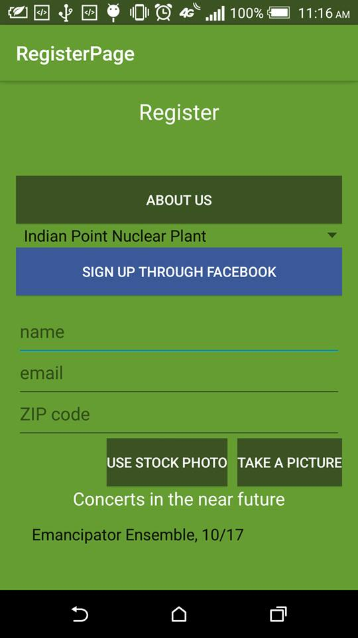
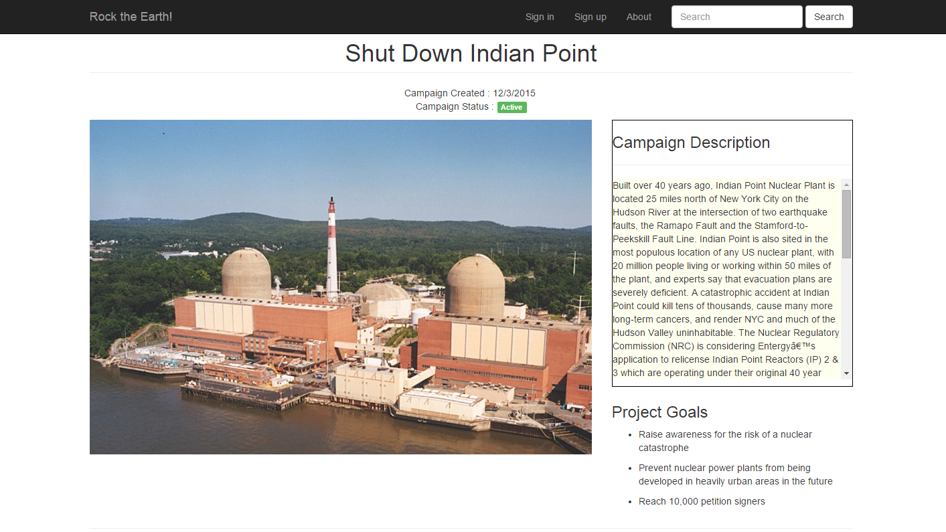
Solution
Mobile solution for easy petitioning
Cloud and offline storage
Web app for photo upload and collaboration

Slide 4
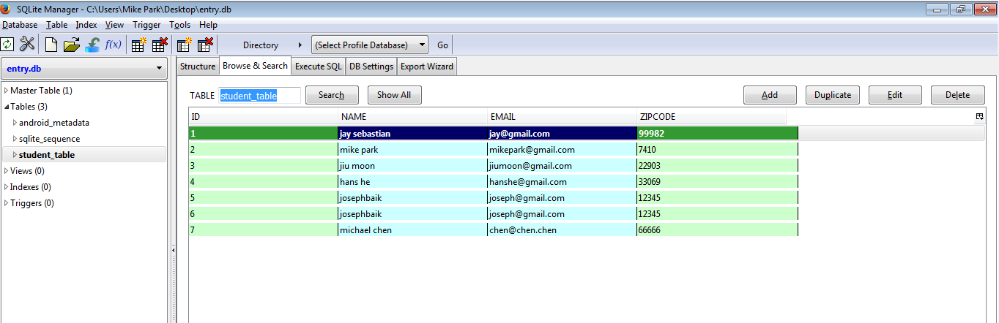
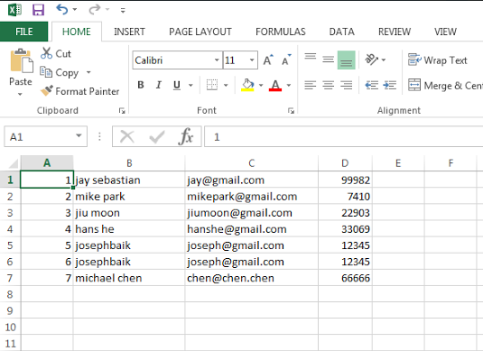
Mobile/Web App
Local Storage
Export
Web App

Slide 5
Future Development
Interface mobile platform with cloud
Integrate social networking features

